Slide 1
Text Processing and Regular Expressions
0
1
2
3
4
H
E
L
L
O
SoftUni Team
Technical Trainers
Software University
http://softuni.bg

Slide 2
Table of Contents
Strings
Manipulating Strings
Additional Functions
Regular Expressions Syntax
Quantifiers and Grouping
Lookbehind/Lookahead
Backreferences

Slide 3
Questions?
sli.do
#tech-js

Slide 4
H
e
l
l
o
Strings
What is String?

Slide 5
What is String?
Strings are sequences of characters (texts)
Strings hold a sequence of characters
Like arrays, they have length (access by index)
Strings are enclosed in three types of quotes:
Concatenated using the "+" operator:
let str = "Hello";
let str = 'Hello';
let str = `Hello`;
let s = "Hello" + " " + "JS";

Slide 6
Strings are Immutable
Strings are immutable (read-only) sequences of characters
Accessible by index
let str = "Hello, JS";
let ch = str[2]; // Expected output: l
ch = str.charAt(2); // Expected output: l
// Both declarations are the same

Slide 7
Problem: Print Characters
Write a function that receives a string and prints all the characters on separate lines
Input
Output
function solve(string) { for (let ch of string) { console.log(ch); } }
AWord
A
W
o
r
d
solve("AWord");
Check your solution here: https://judge.softuni.bg/Contests/1194/Text-Processing-and-Regular-Expressions

Slide 8

Manipulating Strings

Slide 9
Concatenating
Use the "+" or the "+=" operators
Use the concat() method
let text = "Hello" + ", " + "JS!"; // Expected output: "Hello, JS!"
let text = "Hello, ";
text += "John"; // Expected output: "Hello, John"
let greet = "Hello, ";
let name = "John";
let result = greet.concat(name);
console.log(result); // Expected output: "Hello, John"

Slide 10
Problem: Concatenation
Write a function that receives an array of strings and prints a resulting string containing all of them
function solve(arr) { let result = ''; for (let word of arr) { // TODO: Concatenate } console.log(result); }
Input
Output
["First",
"Second",
"Third"]
FirstSecondThird
Check your solution here: https://judge.softuni.bg/Contests/1194/Text-Processing-and-Regular-Expressions

Slide 11
Searching for Substrings
Index of:
Last index of:
let str = "I am JavaScript developer";
console.log(str.indexOf("Java")); // Expected output: 5
console.log(str.indexOf("java")); // Expected output: -1
let str = "Intro to programming";
let last = str.lastIndexOf("o");
console.log(last); // Expected output: 11

Slide 12
Extracting Substrings
Substr:
Substring:
Receives start index and count
let str = "I am JavaScript developer";
let sub = str.substr(5, 10);
console.log(sub); // Expected output: JavaScript
let str = "I am JavaScript developer";
let sub = str.substring(5, 10);
console.log(sub); // Expected output: JavaS

Slide 13

Problem: Substring
Write a function that receives a string and two numbers. The numbers will be a starting index and count of elements to substring
Input
Output
ASentance
1
8
Sentance
function solve(string, startIndex, count) { let result = // TODO Calculate console.log(result); }
Check your solution here: https://judge.softuni.bg/Contests/1194/Text-Processing-and-Regular-Expressions

Slide 14
String Operations
Split:
Includes:
let text = "I love fruits";
let words = text.split(' ');
console.log(words); // Expected output: ['I', 'love', 'fruits']
let text = "I love fruits.";
console.log(text.includes("fruits")); // Expected output: True
console.log(text.includes("banana")); // Expected output: False

Slide 15
String Operations
Replace: replaces first occurrence and result is a new string
let text = "Hello, john@softuni.bg, you have been using john@softuni.bg in your registration.";
let replacedText = text.replace(".bg", ".com");
console.log(replacedText);
//Expected Output: Hello, john@softuni.com, you have been using john@softuni.bg in your registration.

Slide 16
Problem: Censored Words
Write a function that receives a string and a single word. Find all occurrences of that word in the text and replace them with the corresponding amount of '*'
Input
A small sentence with some words
small
Output
A ***** sentence with some words
Check your solution here: https://judge.softuni.bg/Contests/1194/Text-Processing-and-Regular-Expressions

Slide 17
Solution: Censored Words
Save the new text in a new variable
The repeat function should take the length of the word and return that amount of stars '*'
function solve(text, word) { let censored = text.replace(word, repeat(word));
while (censored.includes(word)) {
censored = censored.replace(word, repeat(word));
} //TODO: Create the repeat function }
Check your solution here: https://judge.softuni.bg/Contests/1194/Text-Processing-and-Regular-Expressions

Slide 18

Additional Functions
Checking, Padding, Removing Spaces

Slide 19
Starts with/Ends with
Use startsWith() to determine whether a string begins with the characters of a specified substring
Use endsWith() to determine whether a string ends with the characters of a specified substring
let text = "My name is John";
console.log(text.startsWith('My')); // Expected output: true
let text = "My name is John";
console.log(text.endsWith('John')); // Expected output: true

Slide 20
Padding at the Start and End
Use padStart() to add to the current string another substring at the start until a length is reached
Use padEnd() to add to the current string another substring at the end until a length is reached
Receives length and substring
let bitAsStr = "010";
console.log(text.padStart(8, '0')); // Expected output: 00000010
let sentence = "He passed away";
console.log(text.padEnd(20, '.'));
// Expected output: He passed away......

Slide 21
Trimming Strings
Use trim() method to remove whitespaces (spaces, tabs, no-break space, etc. ) from both ends of a string
Use trimStart() or trimEnd() to remove whitespaces only at the beginning or at the end
let text = " Annoying spaces ";
console.log(text.trim()); // Expected output: "Annoying spaces"
let text = " Annoying spaces ";
text = text.trimStart(); text = text.trimEnd();
console.log(text); // Expected output: "Annoying spaces"

Slide 22
Repeating Strings
Use repeat() to construct and return a new string which contains the specified number of copies of the string on which it was called
let n = 3;
for(let i = 1; i <= n; i++) {
console.log('*'.repeat(i));
}
// *
// **
// ***

Slide 23
[A-Z]
Regular Expressions Syntax
Definition and Classes

Slide 24
What are Regular Expressions?
Match text by pattern
Patterns are defined by special syntax, e.g.
[0-9]+ matches non-empty sequence of digits
[A-Z][a-z]* matches a capital + small letters
Play with regex live at: regexr.com, regex101.com

Slide 25
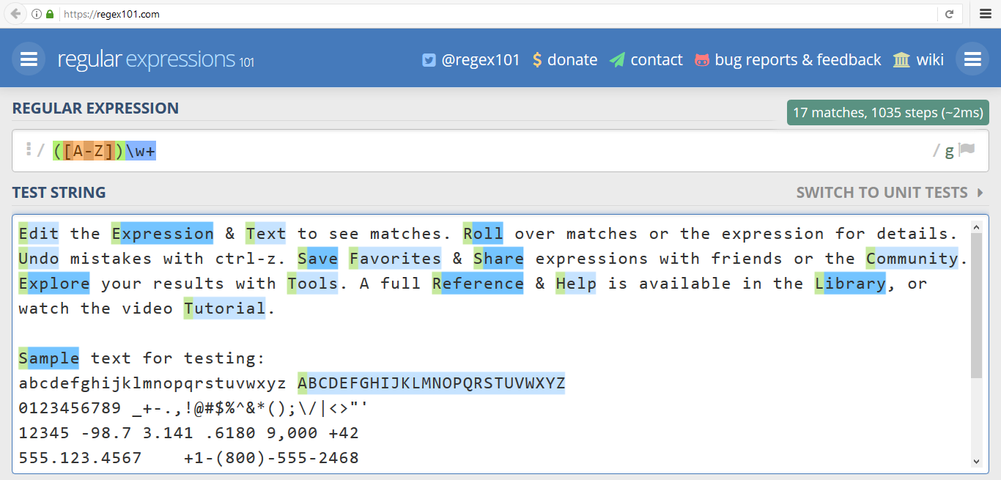
www.regex101.com
Live Demo

Slide 26
Regular Expression Pattern - Example
Regular expressions (regex) describe a search pattern
Used to find / extract / replace / split data from text by pattern
[A-Z][a-z]+ [A-Z][a-z]+
John Smith
Linda Davis
Contact: Alex Scott

Slide 27
Character Classes: Ranges
[nvj] matches any character that is either n, v or j
[^abc] - matches any character that is not a, b or c
[0-9] - character range: matches any digit from 0 to 9
node.js v0.12.2
Abraham
John is 8 years old.

Slide 28
Predefined Classes
\w - Matches any word character (a-z, A-Z, 0-9, _)
\W - Matches any non-word character (the opposite of \w)
\s - Matches any white-space character
\S - Matches any non-white-space character (opposite of \s)
\d - Matches any decimal digit (0-9)
\D - Matches any non-decimal character (the opposite of \d)

Slide 29
(\w+)
Quantifiers and Grouping

Slide 30
Quantifiers
* - Matches the previous element zero or more times
+ - Matches the previous element one or more times
? - Matches the previous element zero or one time
{3} - Matches the previous element exactly 3 times
\+\d*
+359885976002 a+b
\+\d+
+359885976002 a+b
\+\d?
+359885976002 a+b
\+\d{3}
+359885976002 a+b

Slide 31
Grouping Constructs
(subexpression) - captures the matched subexpression as numbered group
(?:subexpression) - defines a non-capturing group
(?<name>subexpression) - defines a named capturing group
\d{2}-(\w{3})-\d{4}
22-Jan-2015
^(?:Hi|hello),\s*(\w+)$
Hi, Peter
(?<day>\d{2})-(?<month>\w{3})-(?<year>\d{4})
22-Jan-2015

Slide 32
Problem: Match Full Name
Write a regular expression in www.regex101.com to match a valid full name, according to these conditions:
A valid full name has the following characteristics:
It consists of two words
Each word starts with a capital letter
After the first letter, it only contains lowercase letters afterwards
Each of the two words should be at least two letters long
The two words are separated by a single space

Slide 33
Solution: Match Full Name
function solve(input) {
let pattern = /\b[A-Z][a-z]+[ ][A-Z][a-z]+\b/g;
let validNames = [];
let validName = null;
while((validName = pattern.exec(input)) !== null){
validNames.push(validName[0]);
}
console.log(validNames.join(' '));
}
Check your solution here: https://judge.softuni.bg/Contests/1194/Text-Processing-and-Regular-Expressions

Slide 34
Problem: Match Phone Number
Match a valid phone number from Sofia. After you find all valid phones, print them on the console, separated by a comma and a space ", "
A valid number has the following characteristics:
It starts with "+359"
Then, it is followed by the area code (always 2)
After that, it's followed by the number itself , which consists of 7 digits (separated in two groups of 3 and 4 digits respectively)
The different parts are separated by either a space or a hyphen ('-')

Slide 35
Solution: Match Phone Number
function regExPhones(input) {
let validNames = [];
let pattern = /(?<!\d)[+]359([ -])2\1\d{3}\1\d{4}\b/g;
while ((validName = pattern.exec(input)) !== null) {
validNames.push(validName[0]);
}
console.log(validNames.join(', '));
}
Check your solution here: https://judge.softuni.bg/Contests/1194/Text-Processing-and-Regular-Expressions

Slide 36
Problem: Match Dates
Write a regular expression that extracts dates from text
Valid date format: "dd-MMM-yyyy"
The separator could be . , - or / and must be the same for the whole date
Examples: 12-Jun-1999, 3/Nov/1999
Input
"13/Jul/1928,
10-Nov-1934,
01/Jan-1951,
f 25.Dec.1937
23/09/1973,
1/Feb/2016"
Output
Day: 13, Month: Jul, Year: 1928
Day: 10, Month: Nov, Year: 1934
Day: 25, Month: Dec, Year: 1937

Slide 37
Solution: Match Dates
function matchValidDates(dates) {
let regex = /\b(?<day>\d{2})([-.\/])(?<month>[A-Z][a-z]{2})\2
(?<year>\d{4})\b/g;
let date = '';
while ((date = regex.exec(dates)) !== null) {
let day = date.groups['day'];
let month = date.groups['month'];
let year = date.groups['year'];
console.log(`Day: ${day}, Month: ${month}, Year: ${year}`)
}
}
Check your solution here: https://judge.softuni.bg/Contests/1194/Text-Processing-and-Regular-Expressions

Slide 38
?<=
Lookahead and Lookbehind
Positive and Negative

Slide 39
Lookahead
Positive lookahead
Find expression A where expression B follows
Negative lookahead
Find expression A where expression B does not follow
A(?=B)
[a-z]+(?=\d+)
A(?!B)
[a-z]+(?!\d+)

Slide 40
Lookbehind
Positive lookbehind
Find expression A where expression B precedes
Negative lookbehind
Find expression A where expression B does not precede
(?<=B)A
(?<=\d)[a-z]+
(?<!B)A
(?<!\d)[a-z]+

Slide 41
\1
Backreferences
Numbered Capturing Group

Slide 42
Backreferences Match Previous Groups
\number - matches the value of a numbered capture group
<(\w+)[^>]*>.*?<\/\1>
<b>Regular Expressions</b> are cool!
<p>I am a paragraph</p> … some text after
Hello, <div>I am a<code>DIV</code></div>!
<span>Hello, I am Span</span>
<a href="https://softuni.bg/">SoftUni</a>

Slide 43

Live Exercises

Slide 44

Summary
Strings are immutable sequences of Unicode characters
String processing methods
Concat(), IndexOf(), Contains(), Substring(), Split(), Replace(), …
Regular expressions describe patterns for searching through text
Can utilize character classes, groups, quantifiers and more
…
…
…

Slide 45
https://softuni.bg/courses/technology-fundamentals

Slide 46













SoftUni Diamond Partners

Slide 47




SoftUni Organizational Partners

Slide 48




Trainings @ Software University (SoftUni)
Software University – High-Quality Education and Employment Opportunities
softuni.bg
Software University Foundation
http://softuni.foundation/
Software University @ Facebook
facebook.com/SoftwareUniversity
Software University Forums
forum.softuni.bg

Slide 49

License
This course (slides, examples, demos, videos, homework, etc.) is licensed under the "Creative Commons Attribution-NonCommercial-ShareAlike 4.0 International" license

